Slide 1

National University of Computer and Emerging Sciences,
Islamabad, Pakistan
Introduction to Convolutional Neural Networks
DS-5006: Deep Learning
Dr. Noshina Tariq
Department of AI and DS

Slide 2
Goals
Review of Previous Lecture
Today’s Lecture
Introduction to Convolutional Neural Networks

Slide 3
Convolutional Neural Networks (CovNet)
In a nutshell, A ConvNet usually has 3 types of layers: 1) Convolutional Layer (CONV) 2) Pooling Layer (POOL) 3) Fully Connected Layer (FC)

Slide 4
Convolution
These are the network parameters to be learned.
1 | -1 | -1
-1 | 1 | -1
-1 | -1 | 1
1 | 0 | 0 | 0 | 0 | 1
0 | 1 | 0 | 0 | 1 | 0
0 | 0 | 1 | 1 | 0 | 0
1 | 0 | 0 | 0 | 1 | 0
0 | 1 | 0 | 0 | 1 | 0
0 | 0 | 1 | 0 | 1 | 0
Filter 1
-1 | 1 | -1
-1 | 1 | -1
-1 | 1 | -1
Filter 2
……
6 x 6 image
Each filter detects a small pattern (3 x 3).

Slide 5
Convolution
1 | -1 | -1
-1 | 1 | -1
-1 | -1 | 1
Filter 1
stride=1
1 | 0 | 0 | 0 | 0 | 1
0 | 1 | 0 | 0 | 1 | 0
0 | 0 | 1 | 1 | 0 | 0
1 | 0 | 0 | 0 | 1 | 0
0 | 1 | 0 | 0 | 1 | 0
0 | 0 | 1 | 0 | 1 | 0
Dot
product
3
-1
6 x 6 image

Slide 6
Convolution
1 | -1 | -1
-1 | 1 | -1
-1 | -1 | 1
Filter 1
If stride=2
1 | 0 | 0 | 0 | 0 | 1
0 | 1 | 0 | 0 | 1 | 0
0 | 0 | 1 | 1 | 0 | 0
1 | 0 | 0 | 0 | 1 | 0
0 | 1 | 0 | 0 | 1 | 0
0 | 0 | 1 | 0 | 1 | 0
3
-3
6 x 6 image

Slide 7
Convolution
1 | -1 | -1
-1 | 1 | -1
-1 | -1 | 1
Filter 1
stride=1
1 | 0 | 0 | 0 | 0 | 1
0 | 1 | 0 | 0 | 1 | 0
0 | 0 | 1 | 1 | 0 | 0
1 | 0 | 0 | 0 | 1 | 0
0 | 1 | 0 | 0 | 1 | 0
0 | 0 | 1 | 0 | 1 | 0
3
-1
-3
-1
-3
1
0
-3
-3
-3
0
1
3
-2
-2
-1
6 x 6 image

Slide 8
Convolution
-1 | 1 | -1
-1 | 1 | -1
-1 | 1 | -1
Filter 2
stride=1
Repeat this for each filter
1 | 0 | 0 | 0 | 0 | 1
0 | 1 | 0 | 0 | 1 | 0
0 | 0 | 1 | 1 | 0 | 0
1 | 0 | 0 | 0 | 1 | 0
0 | 1 | 0 | 0 | 1 | 0
0 | 0 | 1 | 0 | 1 | 0
3
-1
-3
-1
-1
-1
-1
-1
-3
1
0
-3
-1
-1
-2
1
Feature
Map
-3
-3
0
1
-1
-1
-2
1
3
-2
-2
-1
6 x 6 image
-1
0
-4
3
Two 4 x 4 images
Forming 2 x 4 x 4 matrix

Slide 9
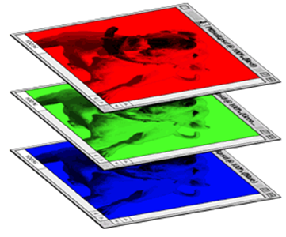
Color image: RGB 3 channels
1 | -1 | -1
-1 | 1 | -1
-1 | -1 | 1
-1 | 1 | -1
-1 | 1 | -1
-1 | 1 | -1
1 | -1 | -1
-1 | 1 | -1
-1 | -1 | 1
-1 | 1 | -1
-1 | 1 | -1
-1 | 1 | -1
1 | -1 | -1
-1 | 1 | -1
-1 | -1 | 1
-1 | 1 | -1
-1 | 1 | -1
-1 | 1 | -1
Filter 1
Filter 2
Color image
1 | 0 | 0 | 0 | 0 | 1
0 | 1 | 0 | 0 | 1 | 0
0 | 0 | 1 | 1 | 0 | 0
1 | 0 | 0 | 0 | 1 | 0
0 | 1 | 0 | 0 | 1 | 0
0 | 0 | 1 | 0 | 1 | 0
1 | 0 | 0 | 0 | 0 | 1
0 | 1 | 0 | 0 | 1 | 0
0 | 0 | 1 | 1 | 0 | 0
1 | 0 | 0 | 0 | 1 | 0
0 | 1 | 0 | 0 | 1 | 0
0 | 0 | 1 | 0 | 1 | 0
1 | 0 | 0 | 0 | 0 | 1
0 | 1 | 0 | 0 | 1 | 0
0 | 0 | 1 | 1 | 0 | 0
1 | 0 | 0 | 0 | 1 | 0
0 | 1 | 0 | 0 | 1 | 0
0 | 0 | 1 | 0 | 1 | 0

Slide 10
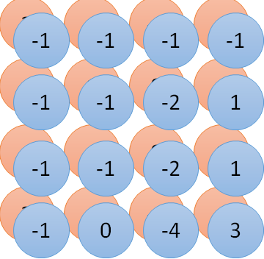
Convolution v.s. Fully Connected
1 | 0 | 0 | 0 | 0 | 1
0 | 1 | 0 | 0 | 1 | 0
0 | 0 | 1 | 1 | 0 | 0
1 | 0 | 0 | 0 | 1 | 0
0 | 1 | 0 | 0 | 1 | 0
0 | 0 | 1 | 0 | 1 | 0
1 | -1 | -1
-1 | 1 | -1
-1 | -1 | 1
-1 | 1 | -1
-1 | 1 | -1
-1 | 1 | -1
convolution
image
1 | 0 | 0 | 0 | 0 | 1
0 | 1 | 0 | 0 | 1 | 0
0 | 0 | 1 | 1 | 0 | 0
1 | 0 | 0 | 0 | 1 | 0
0 | 1 | 0 | 0 | 1 | 0
0 | 0 | 1 | 0 | 1 | 0
Fully-connected
……
……

Slide 11
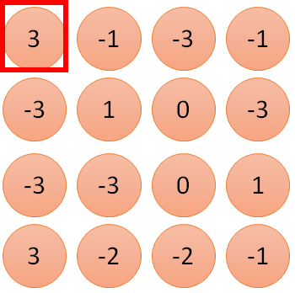
1 | -1 | -1
-1 | 1 | -1
-1 | -1 | 1
1
1
Filter 1
2
0
3
0
3
4:
0
1 | 0 | 0 | 0 | 0 | 1
0 | 1 | 0 | 0 | 1 | 0
0 | 0 | 1 | 1 | 0 | 0
1 | 0 | 0 | 0 | 1 | 0
0 | 1 | 0 | 0 | 1 | 0
0 | 0 | 1 | 0 | 1 | 0
…
0
8
1
9
0
10:
0
…
13
0
6 x 6 image
14
0
fewer parameters!
15
Only connect to 9 inputs, not fully connected
1
16
1
…

Slide 12
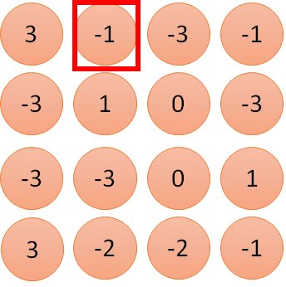
1 | -1 | -1
-1 | 1 | -1
-1 | -1 | 1
1:
1
Filter 1
2:
0
3:
0
3
4:
0
1 | 0 | 0 | 0 | 0 | 1
0 | 1 | 0 | 0 | 1 | 0
0 | 0 | 1 | 1 | 0 | 0
1 | 0 | 0 | 0 | 1 | 0
0 | 1 | 0 | 0 | 1 | 0
0 | 0 | 1 | 0 | 1 | 0
…
7:
0
8:
1
-1
9:
0
10:
0
…
13:
0
6 x 6 image
14:
0
Fewer parameters
15:
1
16:
1
Shared weights
Even fewer parameters
…

Slide 13
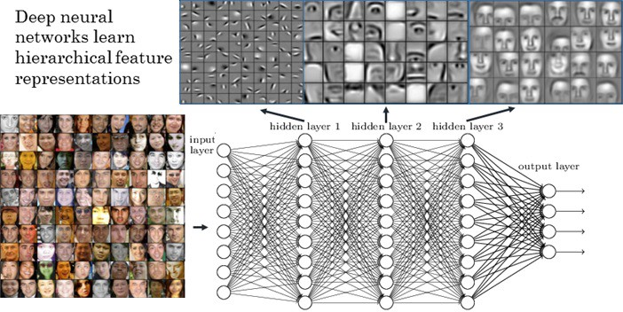
Visualize the Results

Slide 14
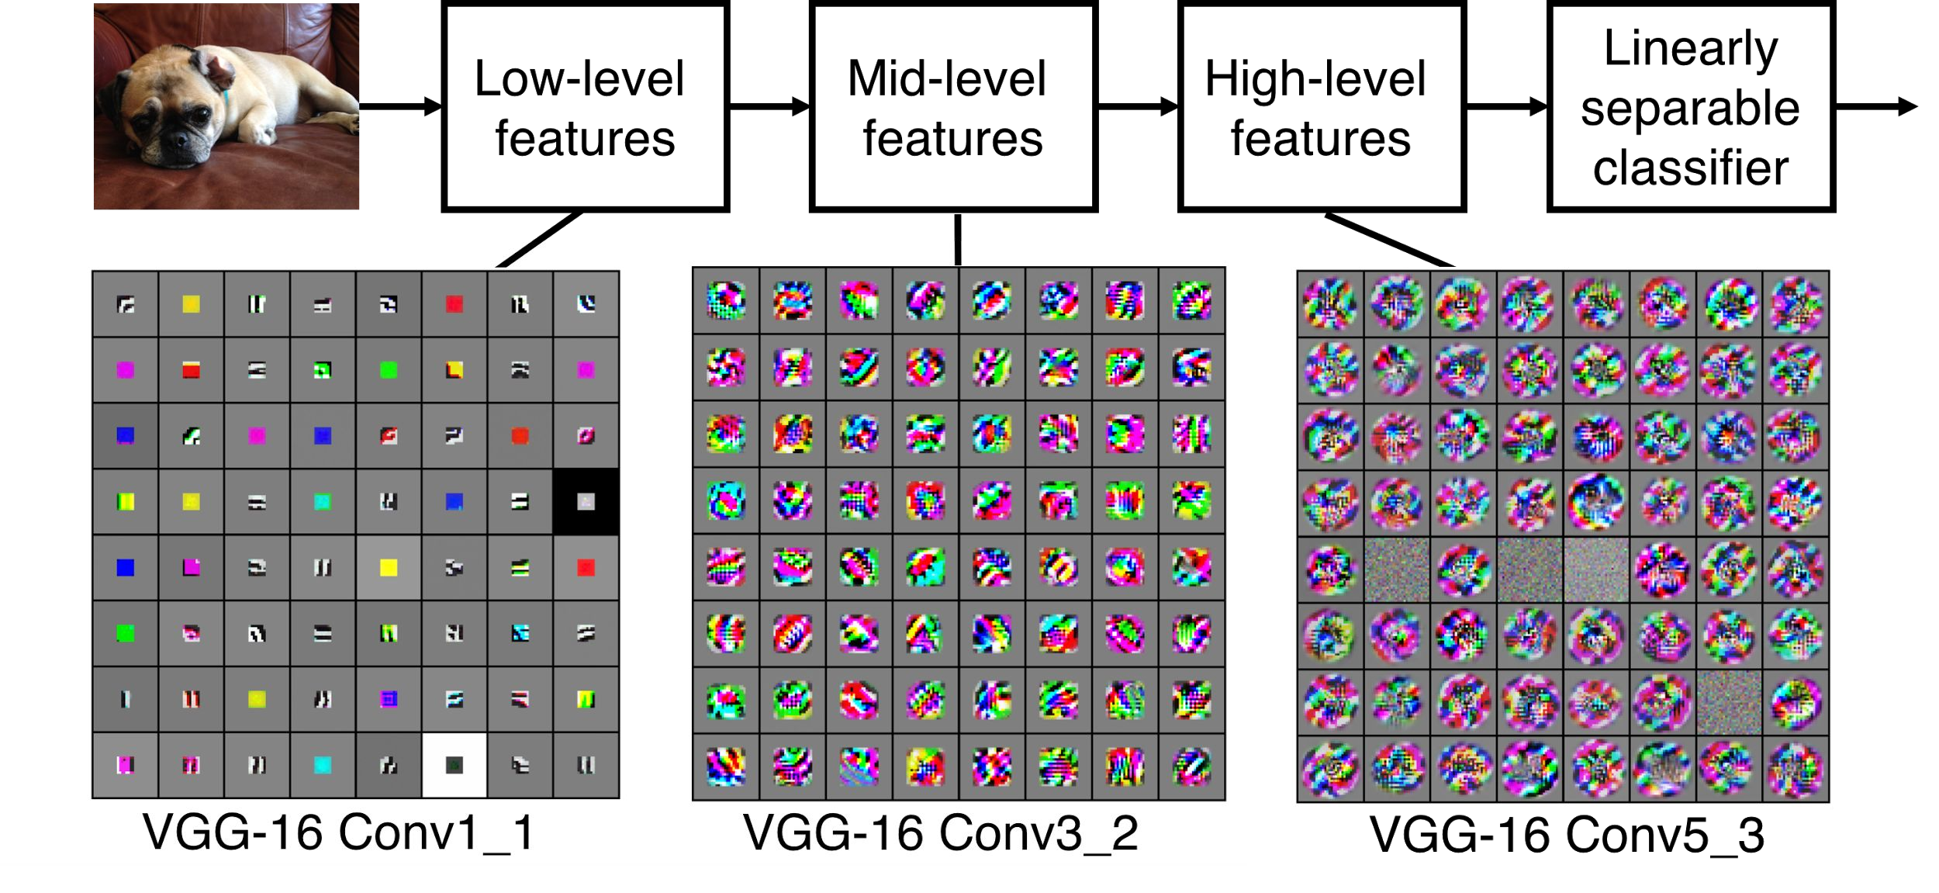
Preview
[Zeiler and Fergus 2013]
Visualization of VGG-16 by Lane McIntosh. VGG-16 architecture from [Simonyan and Zisserman 2014].
Fei-Fei Li & Justin Johnson & Serena Yeung April 18, 2017Lecture 5 -

Slide 15
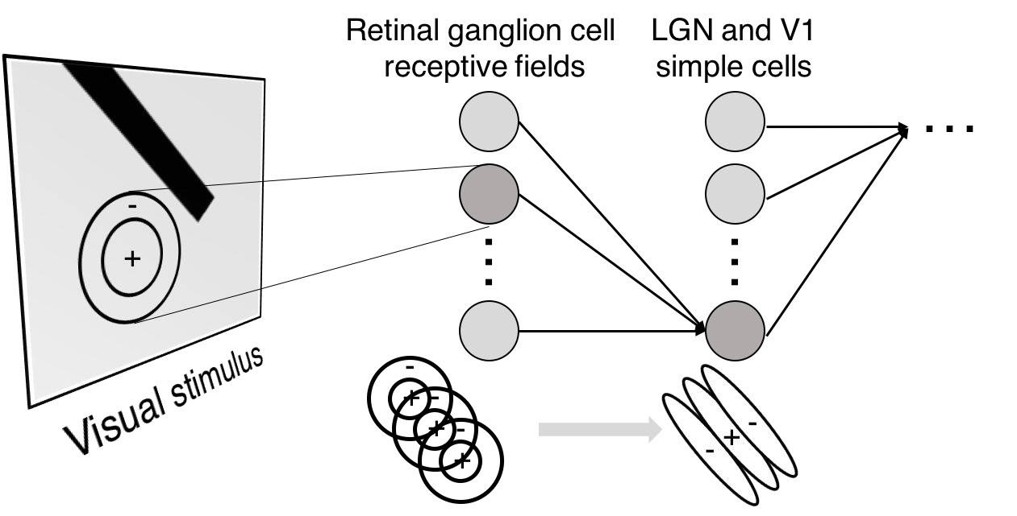
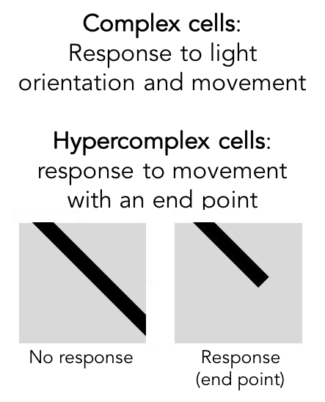
Preview

Slide 16
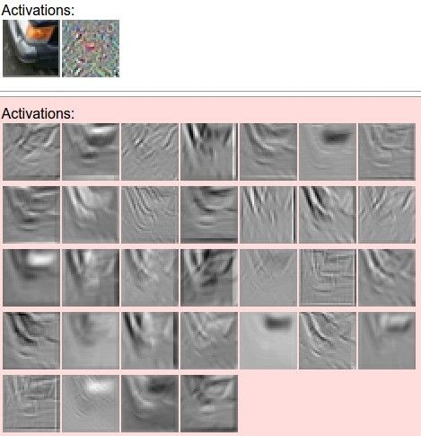
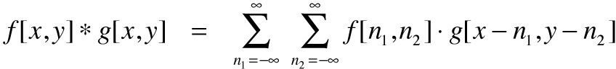
one filter =>
one activation map
example 5x5 filters
(32 total)
We call the layer convolutional because it is related to convolution of two signals:
elementwise multiplication and sum of a filter and the signal (image)
Figure copyright Andrej Karpathy.

Slide 17

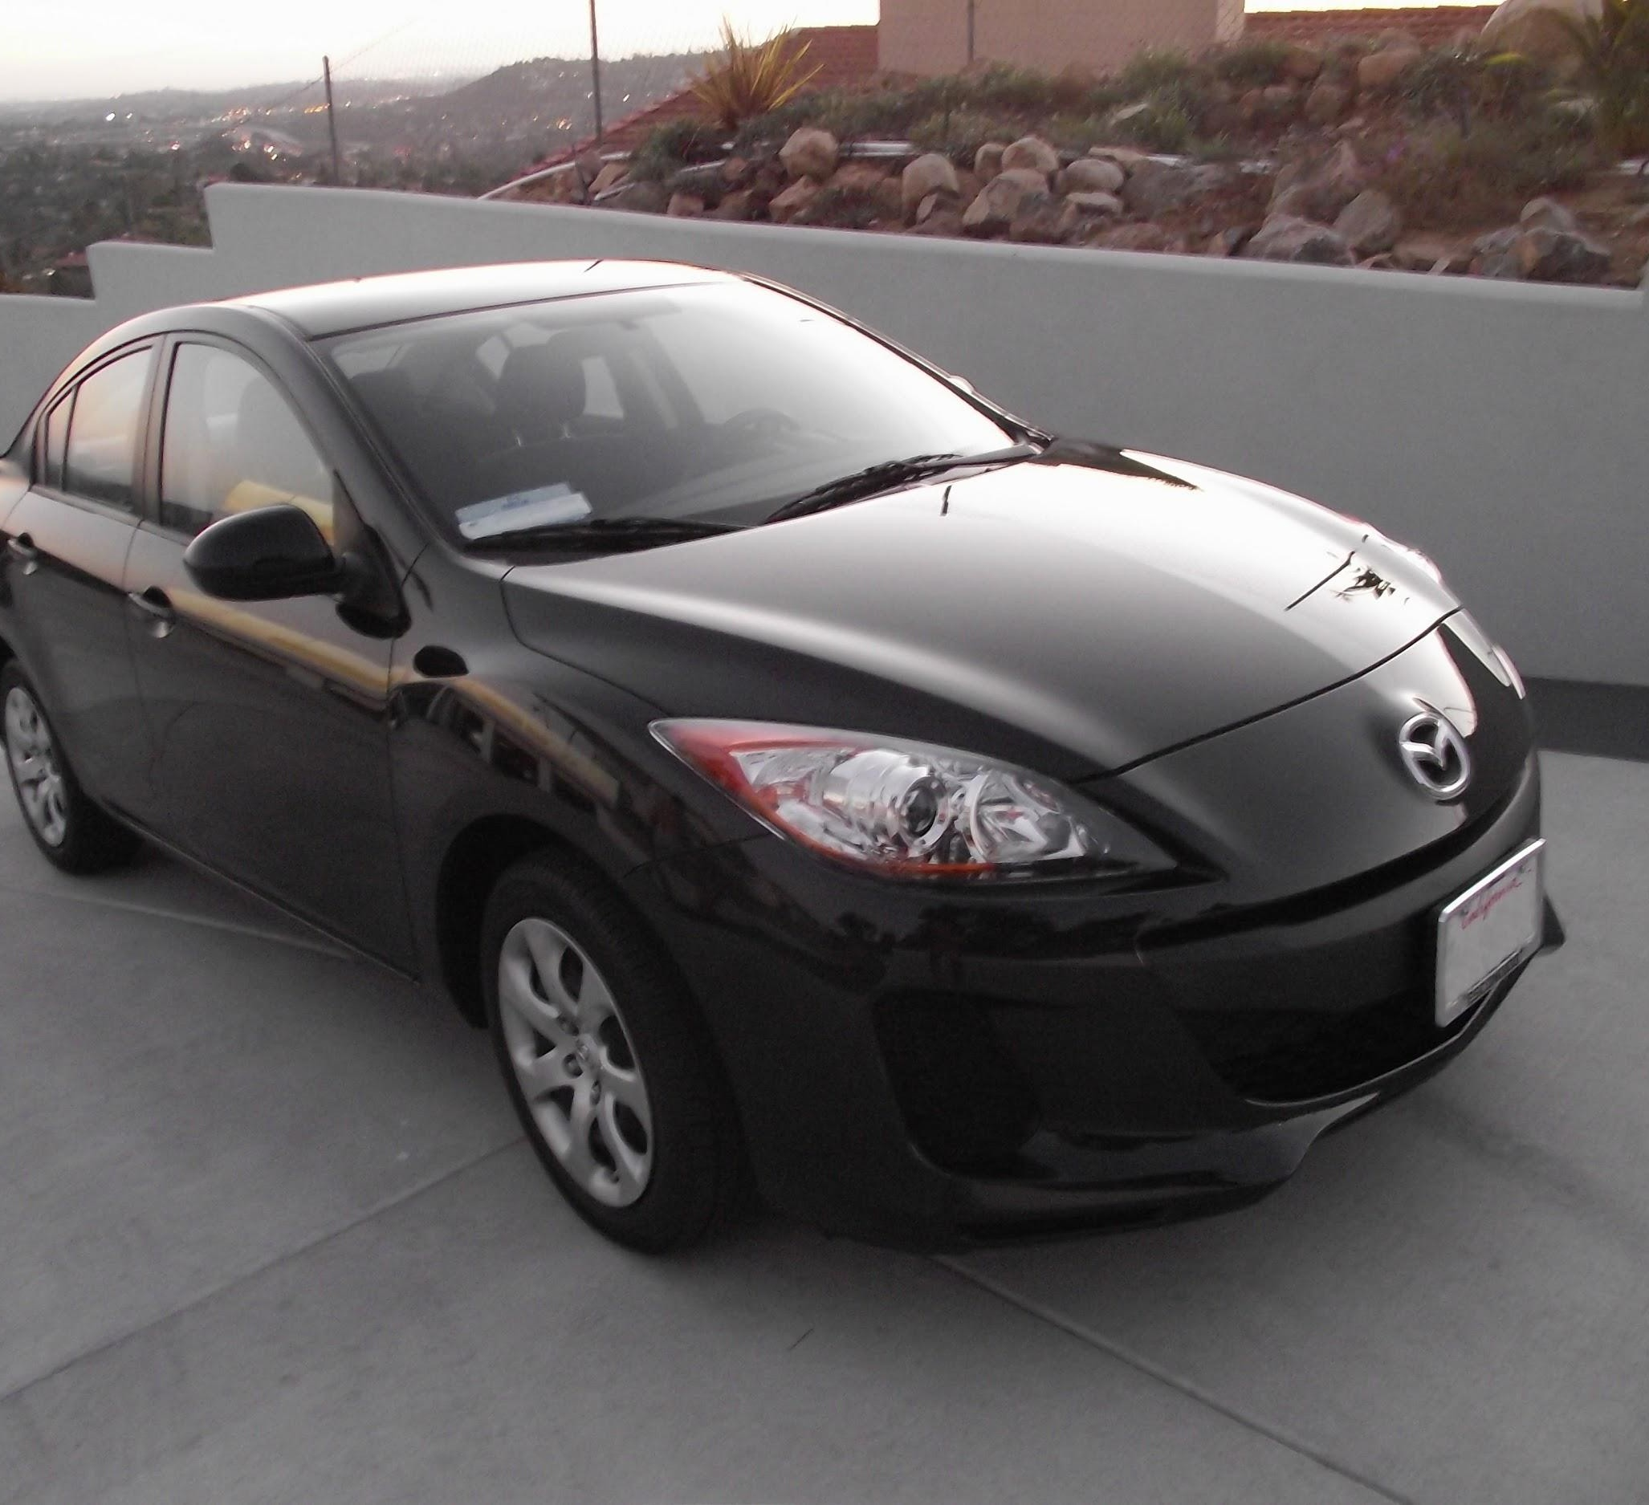
preview:
Fei-Fei Li & Justin Johnson & Serena Yeung April 18, 2017Lecture 5 -

Slide 18


The whole CNN
cat dog ……
Convolution
Max Pooling
Can repeat many times
Fully Connected Feedforward network
Convolution
Max Pooling
Flattened

Slide 19
Flattening
3
0
1
3
0
-1
1
3
3
1
-1
0
3
Flattened
1
Fully Connected Feedforward network
0
3

Slide 20
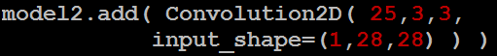
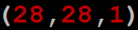
CNN in Keras
Only modified the network structure and input format (vector -> 3-D tensor)
input
Convolution
1 | -1 | -1
-1 | 1 | -1
-1 | -1 | 1
-1 | 1 | -1
-1 | 1 | -1
-1 | 1 | -1
There are 25 3x3 filters.
……
Max Pooling
Input_shape = ( 28 , 28 , 1)
28 x 28 pixels
1: black/white, 3: RGB
Convolution
3
-1
3
Max Pooling
-3
1

Slide 21
CNN in Keras
Only modified the network structure and input format (vector -> 3-D array)
Input
1 x 28 x 28
Convolution
How many parameters for each filter?
9
25 x 26 x 26
Max Pooling
25 x 13 x 13
Convolution
How many parameters
for each filter?
225=
25x9
50 x 11 x 11
Max Pooling
50 x 5 x 5

Slide 22
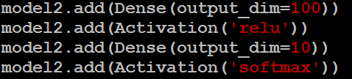
CNN in Keras
Only modified the network structure and input format (vector -> 3-D array)
Input
1 x 28 x 28
Output
Convolution
25 x 26 x 26
Fully connected feedforward network
Max Pooling
25 x 13 x 13
Convolution
50 x 11 x 11
Max Pooling
1250
50 x 5 x 5
Flattened

Slide 23
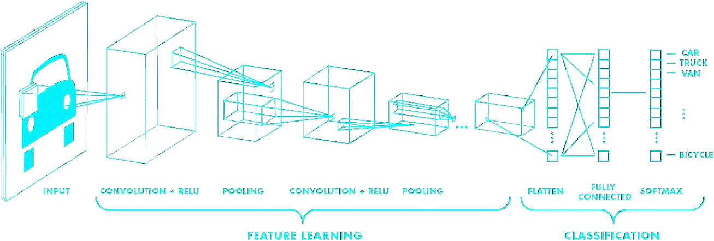
Putting it all together
import tensorflow as tf
def generate_model():
model = tf.keras.Sequential([ # first convolutional layer
tf.keras.layers.Conv2D(32, filter_size=3, activation='relu’), tf.keras.layers.MaxPool2D(pool_size=2, strides=2),
# second convolutional layer
tf.keras.layers.Conv2D(64, filter_size=3, activation='relu’), tf.keras.layers.MaxPool2D(pool_size=2, strides=2),
# fully connected classifier tf.keras.layers.Flatten(), tf.keras.layers.Dense(1024, activation='relu’), tf.keras.layers.Dense(10, activation=‘softmax’) # 10 outputs
])
return model

Slide 24
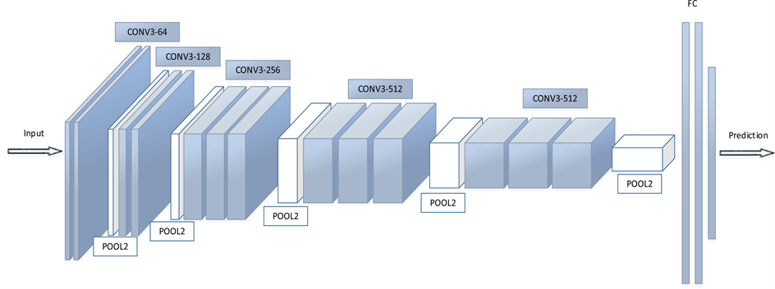
Fully Connected Layers

Slide 25
Fully Connected Layers
Regular neural network
This layer takes an input volume from last layer of CNN and outputs an N dimensional vector.
Where N is the number of classes

Slide 26
Pooling Layer
Pooling is used to progressively reduce the spatial size of the input
To reduce the amount of parameters and computation
It control overfitting (regularization).
Invariance to small translations of the input
Commonly insert a Pooling layer in-between successive Conv layers

Slide 27
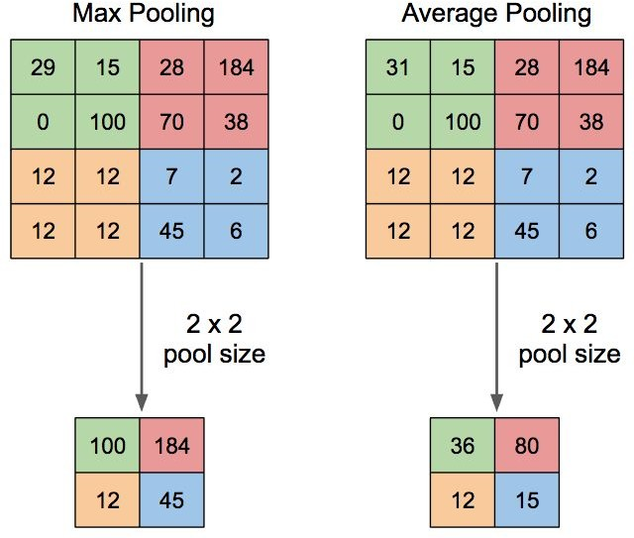
Pooling Layer

Slide 28
Implementing ML Models

Slide 29
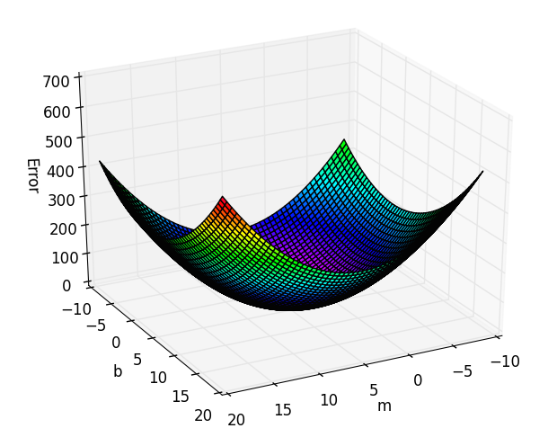
Error surfaces

Slide 30
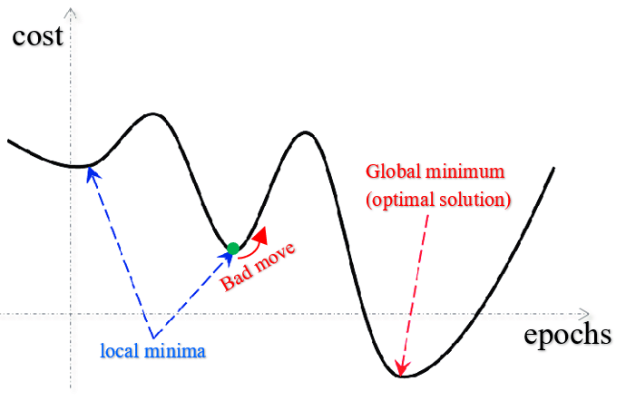
Error surfaces

Slide 31
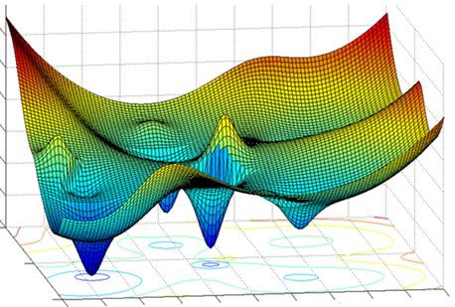
Error surfaces

Slide 32
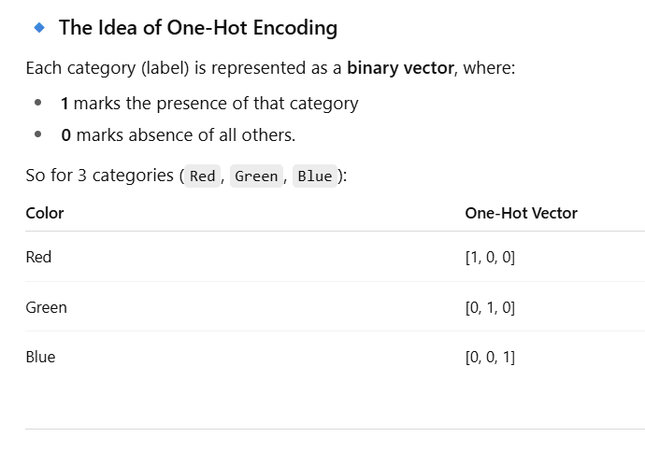
One Hot Encoding
Machine learning models expect numeric data for training
e.g. preprocess text to some numeric representation
Image pixels are numeric, can extract more features
Sensor data can be represented in numeric form
In case of classification, the labels should be integers.
Instead of integers, one-hot encoding is more useful for training some neural networks

Slide 33
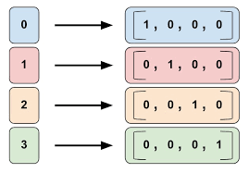
One Hot Encoding

Slide 34
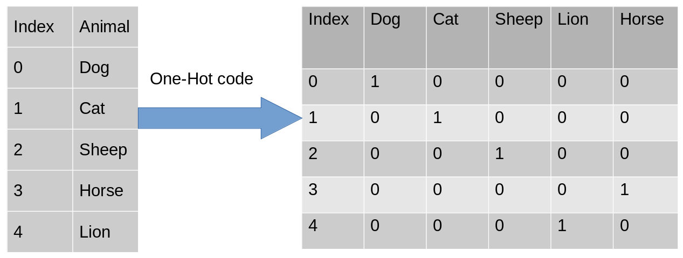
One Hot Encoding

Slide 35
Activation Functions
Backpropagation can work with any activation function
The activation function should at least meet the criteria of
Differentiability, continuity, nonlinearity.
The sigmoid function possesses the desirable properties of the activation function

Slide 36
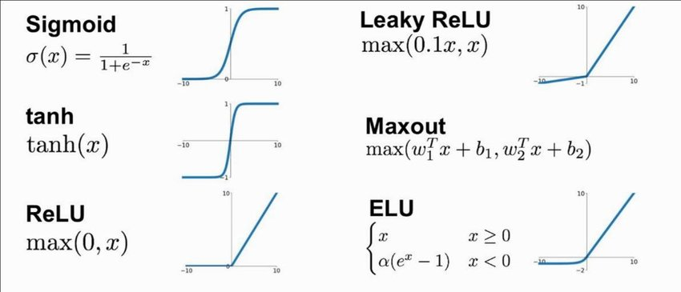
Activation Functions
Backpropagation can work with any activation function
The activation function should meet the criteria of
Differentiabity, continuity, nonlinear.
The sigmoid function possesses the desirable properties of the activation function

Slide 37
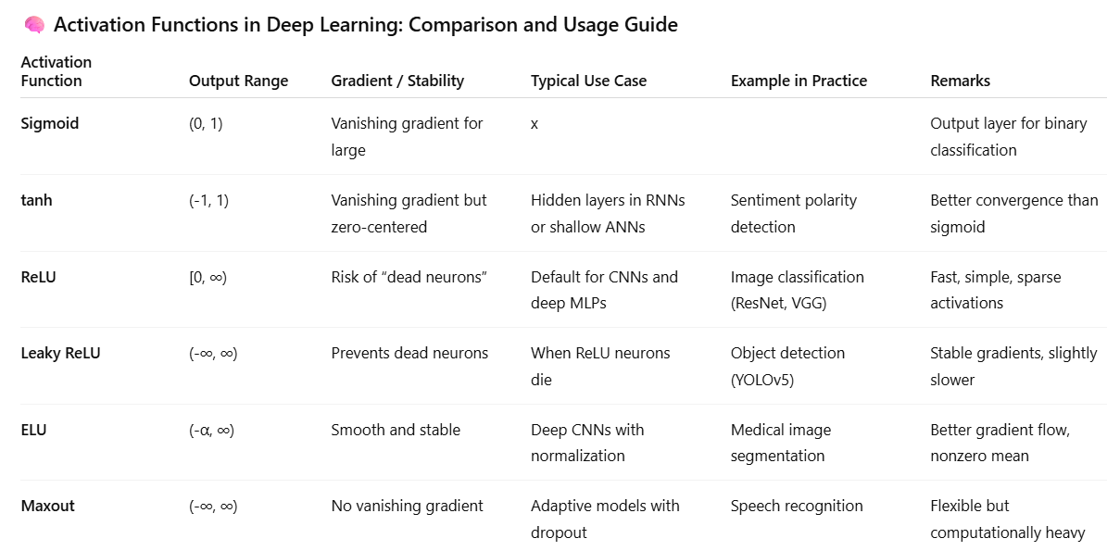

Slide 38
Number of hidden units
The number of hidden neurons (n_{H}) is crucial for extracting powerful features
The complexity of the decision boundary.
For linearly separable data few hidden units are needed
For complex and nonlinear data, more hidden neurons are needed.
No recommended number of hidden units
We should not have more weights than the total number of training samples

Slide 39
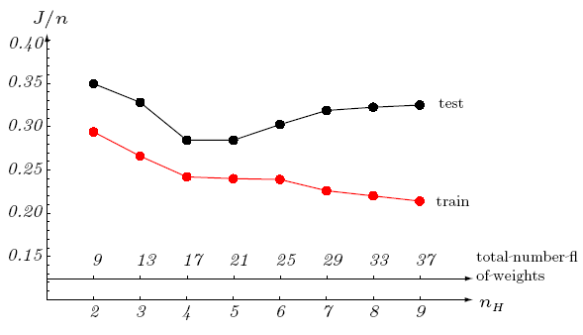
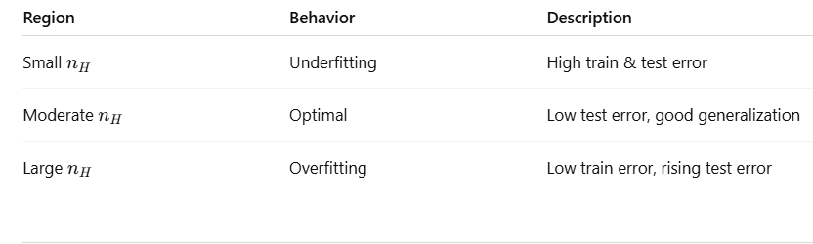
Number of hidden units

Slide 40
Initializing weights
The weight values should be initialized to have fast and uniform learning .
All weights reach their optimum values at about the same time.
If some weights converge significantly earlier than others (non-uniform learning) then the network may not perform well throughout the full range of inputs or for each class
Example: when class C_{i} is learned well before C_{j} .
A possible solution is to use data standardization

Slide 41
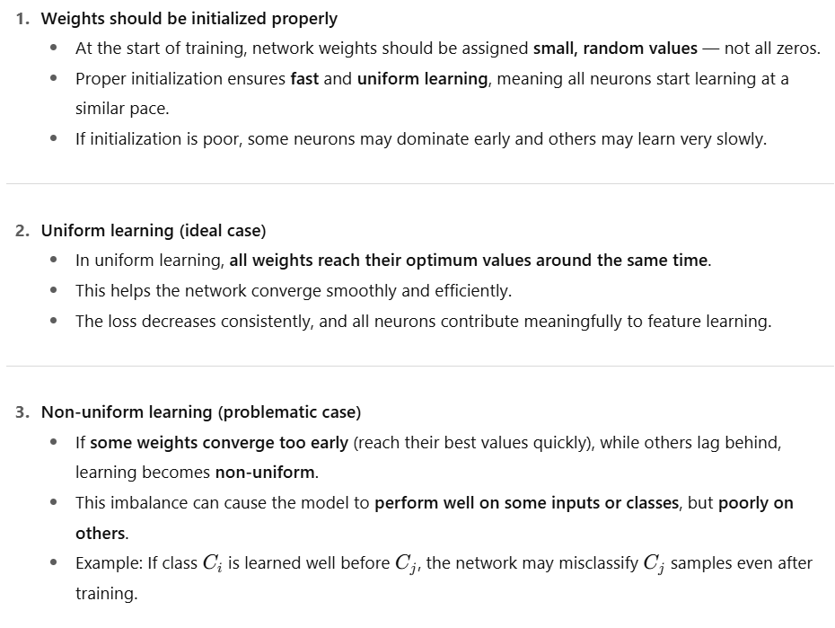

Slide 42
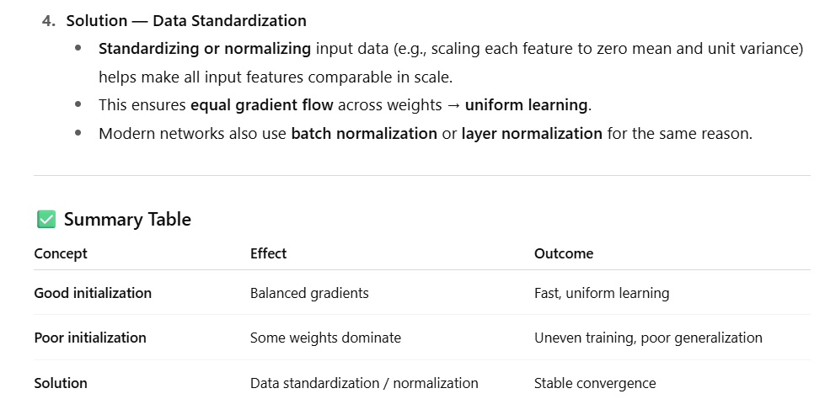

Slide 43
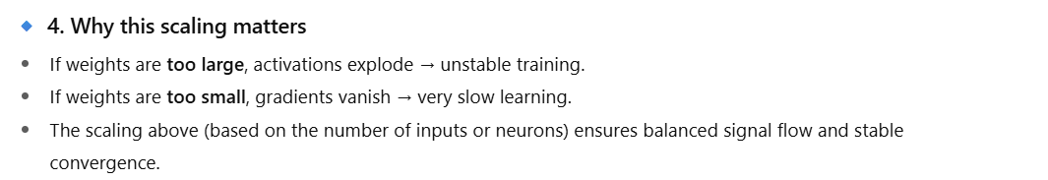
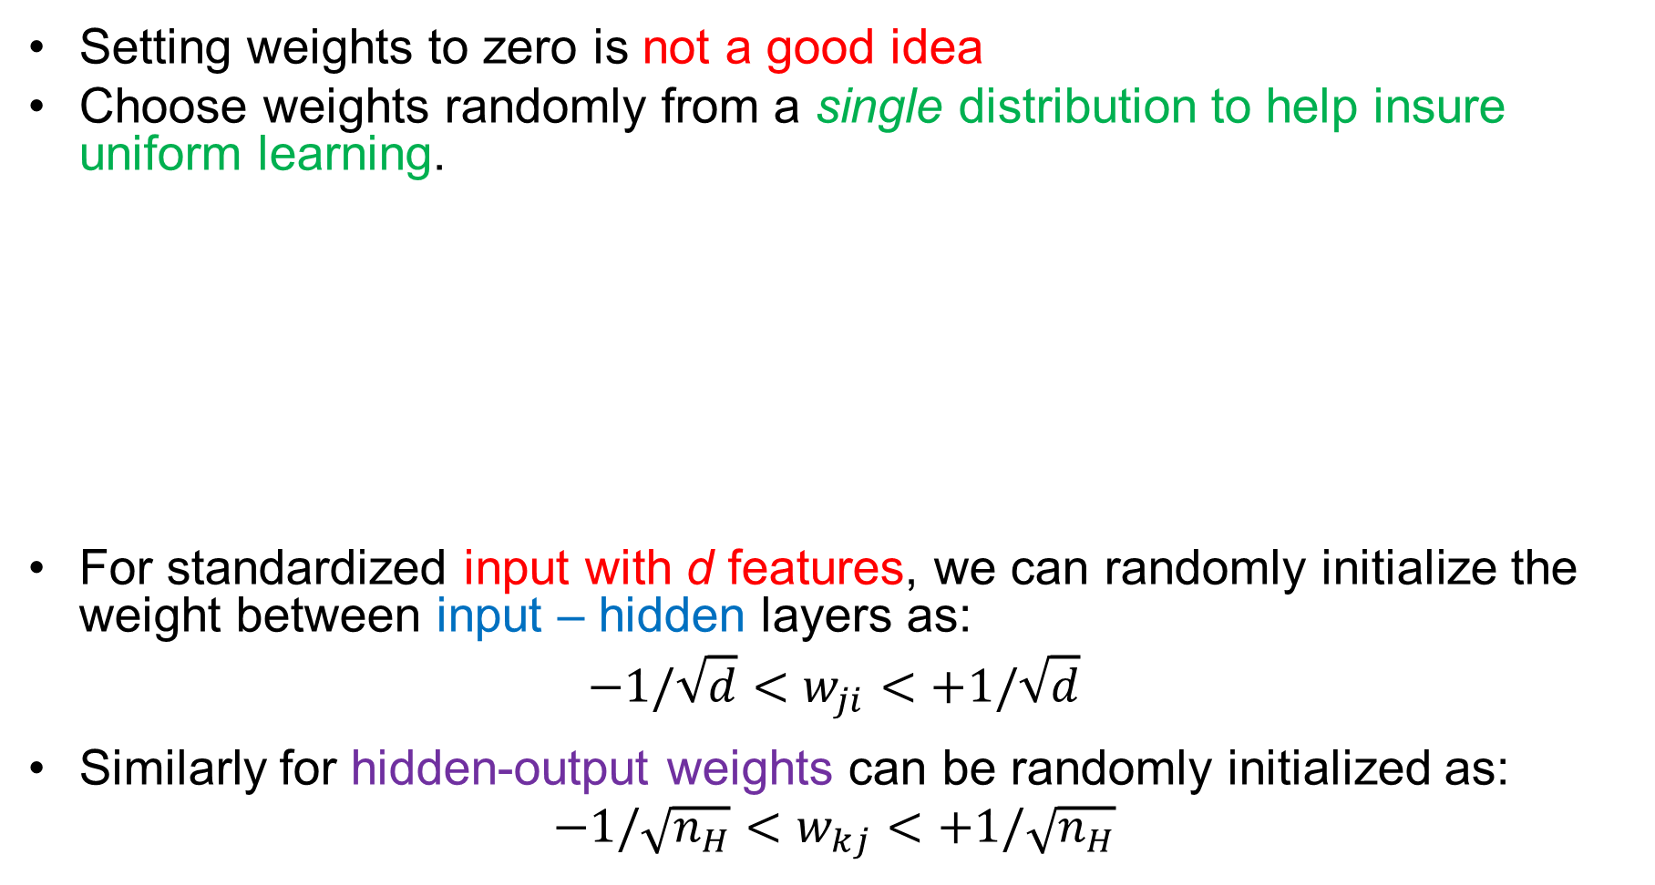
Initializing weights
Setting weights to zero is not a good idea
Choose weights randomly from a single distribution to help insure uniform learning.
For standardized input with d features, we can randomly initialize the weight between input – hidden layers as:
$$−1/\sqrt{d}<w_{ji}<+1/\sqrt{d}$$
Similarly for hidden-output weights can be randomly initialized as:
$$−1/\sqrt{n_{H}}<w_{kj}<+1/\sqrt{n_{H}}$$

Slide 44
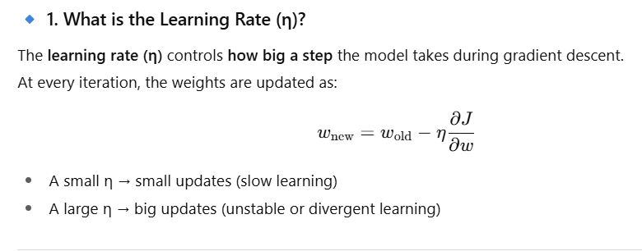
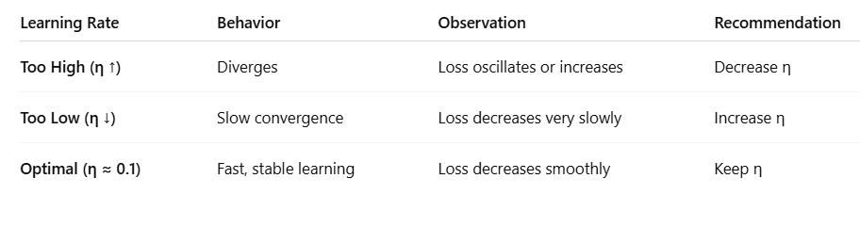
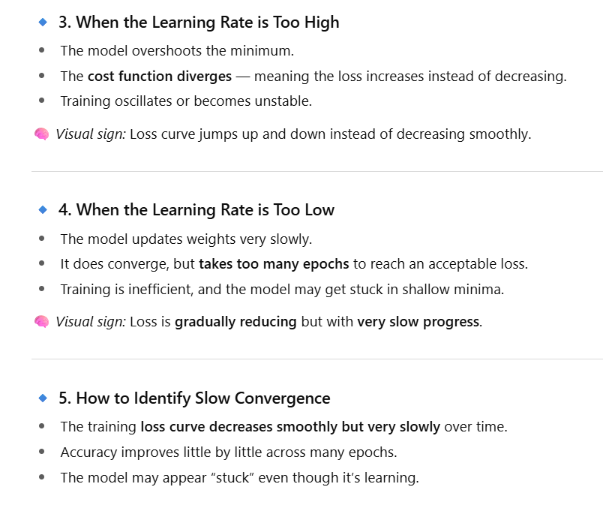
Learning rates

Slide 45
Learning rates
The optimal learning rate is the one which leads to the minimum local error in one
Generally, learning step of η = 0.1 is good for starting
Lower it if the cost function diverges
(The cost function tells the model how bad its predictions are, so it can adjust its weights to do better in the next iteration.)
Raised it the cost function is too slow to converge.
How to identify slow convergence?
Loss is gradually reducing but take too many epochs
The training loss curve decreases smoothly but very slowly over time.
Accuracy improves little by little across many epochs.
The model may appear “stuck” even though it’s learning.

Slide 46
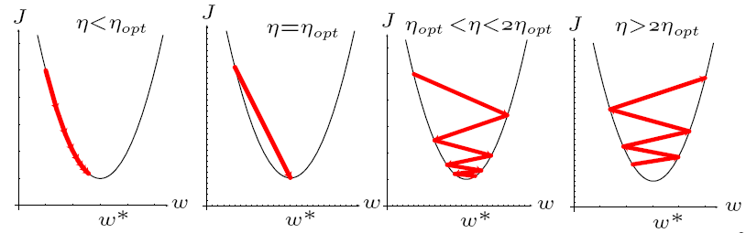
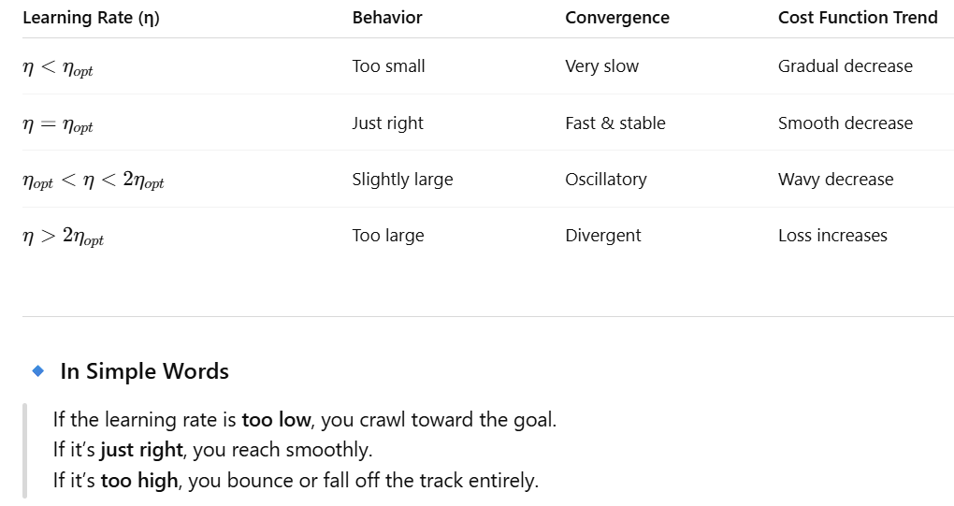
Learning rates

Slide 47
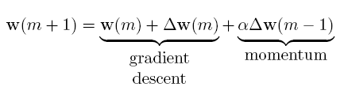

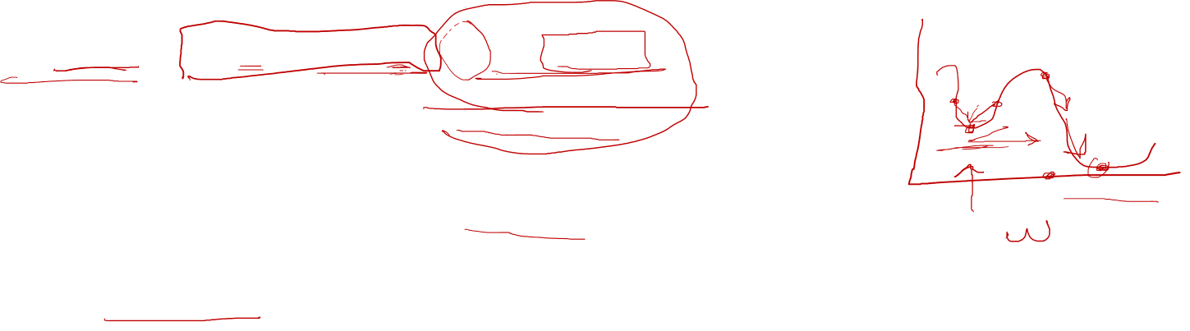
Momentum
Error surfaces often have plateaus regions
The slope dJ(w)/dw is very small
Too many weights.
Momentum- allows the network to learn weights more quickly when plateaus in the error surface exist.
The learning rule in backpropagation can be updated as:
α must be less than 1.0 for stability, typical value α = 0.9.
Affect is like averaging the stochastic variations in weight updates
Can also help overcome local minima

Slide 48
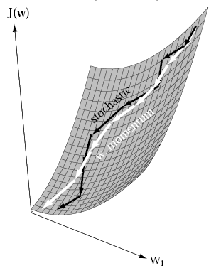
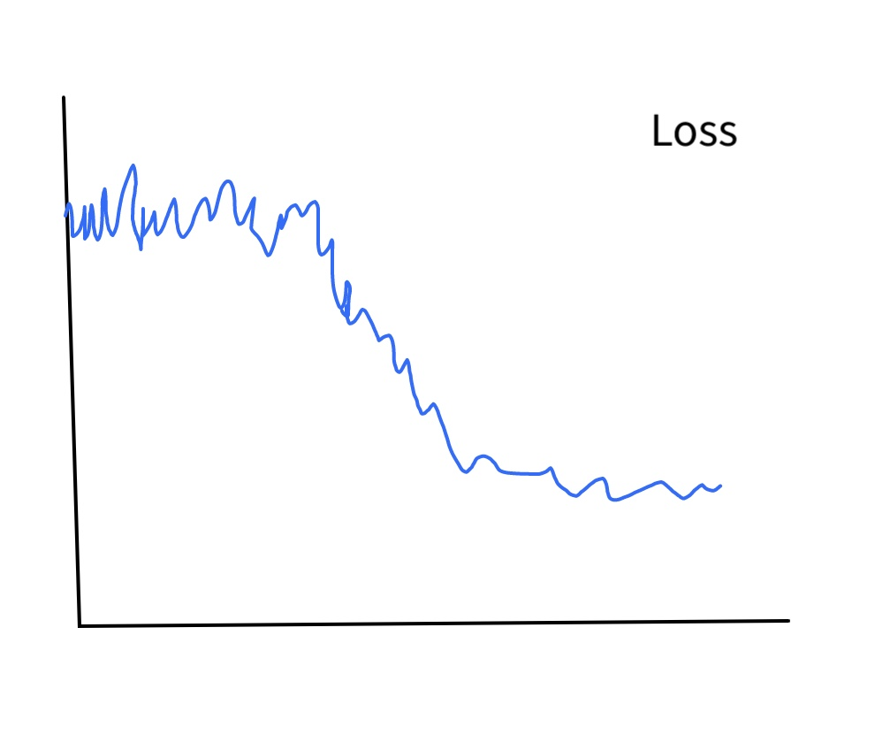
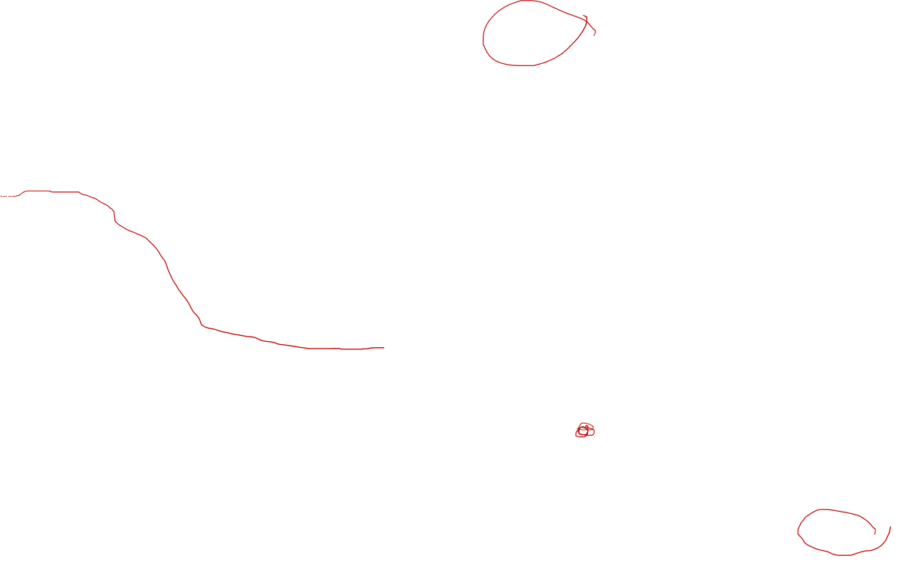
Momentum

Slide 49

Overfitting
A model learns too well from training data, capturing noise and irrelevant patterns (memorizing)
It performs well on training data but poorly on unseen/test data.
Causes:
Excessive model complexity (too many parameters).
Insufficient training data.
Training for too many epochs.
Lack of regularization (e.g., dropout, L1/L2 regularization).
How can we find if model is overfitting?
High training accuracy but low test accuracy.
Large gap between training and validation performance.

Slide 50
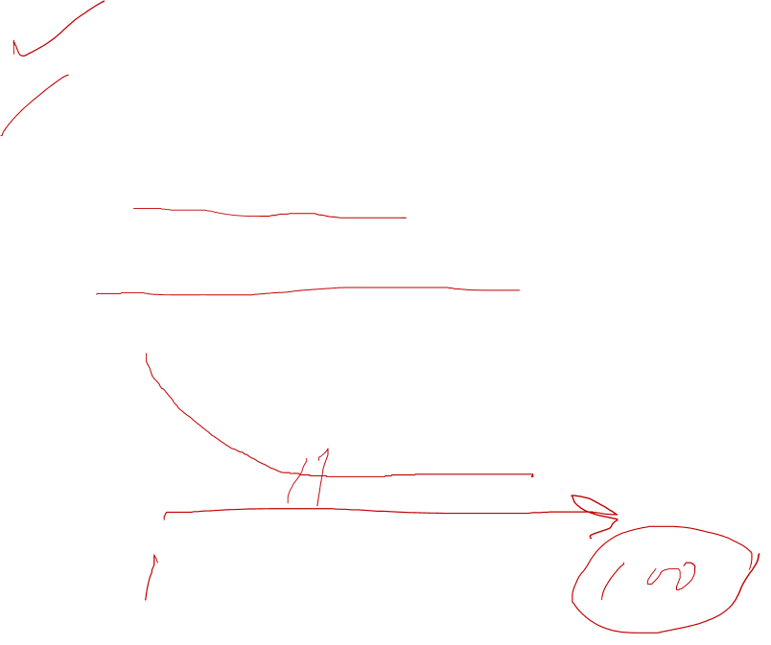
Overfitting
Solutions:
Increase training data (data augmentation, synthetic data).
Use regularization techniques (L1, L2, dropout).
Reduce model complexity (simpler architecture, fewer parameters).
Apply early stopping (stop training when validation loss starts increasing).

Slide 51

Underfitting
A model is too simple to capture the underlying patterns in the data.
It results in poor performance on both training and test data.
Causes:
Model complexity is too low.
Insufficient training time (not enough epochs).
Poor feature selection or preprocessing.
High bias (model assumptions are too restrictive).
Indicators:
Low training and validation accuracy.
High bias in predictions (simplistic decision boundaries).

Slide 52
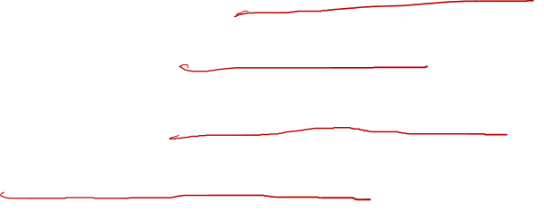
Underfitting
Solutions:
Increase model complexity (use deeper networks, add more neurons).
Train for more epochs.
Improve feature engineering (extract relevant features).
Reduce regularization if it is too strong.

Slide 53
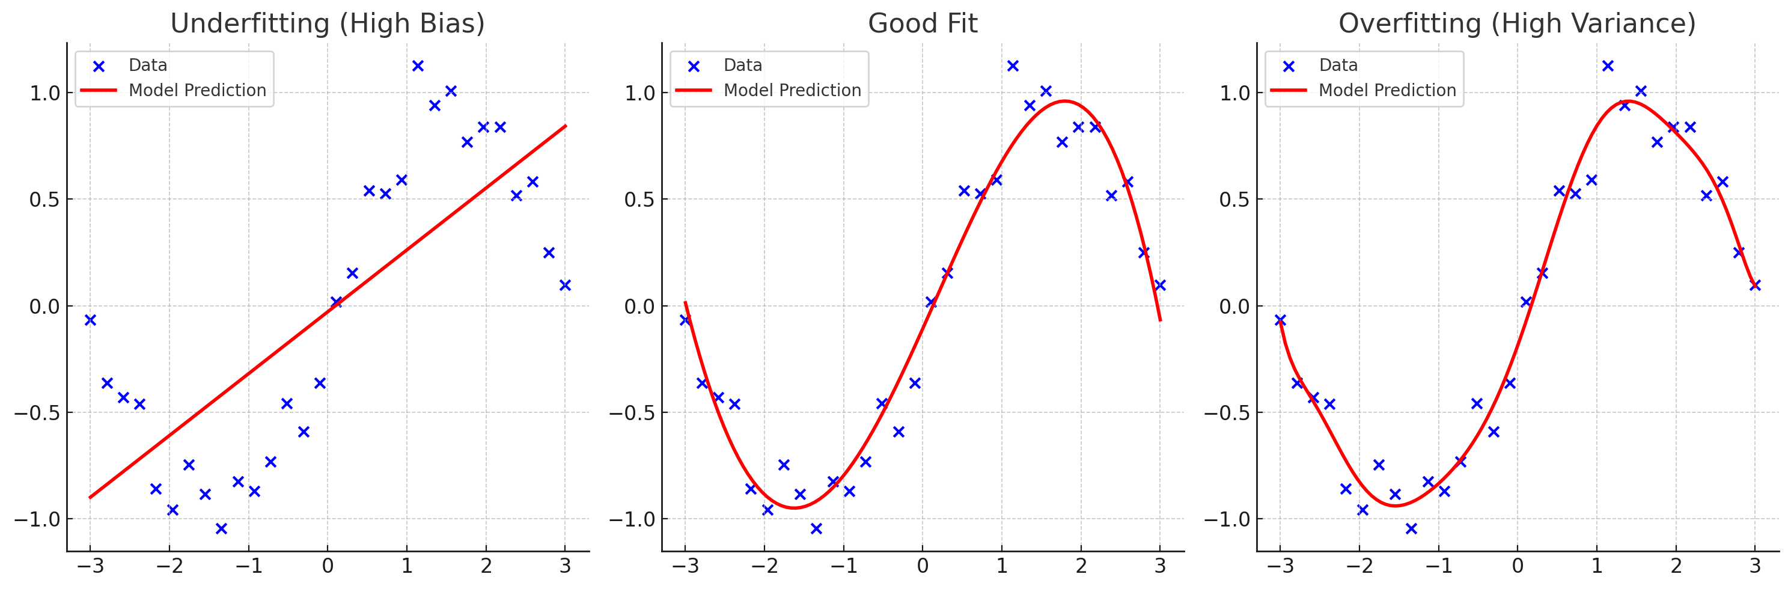
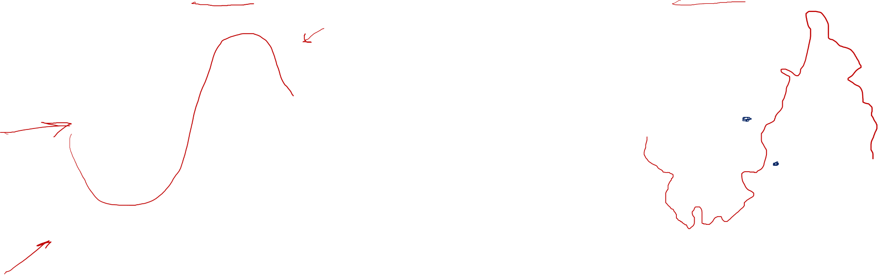
Underfitting vs Overfitting

Slide 54
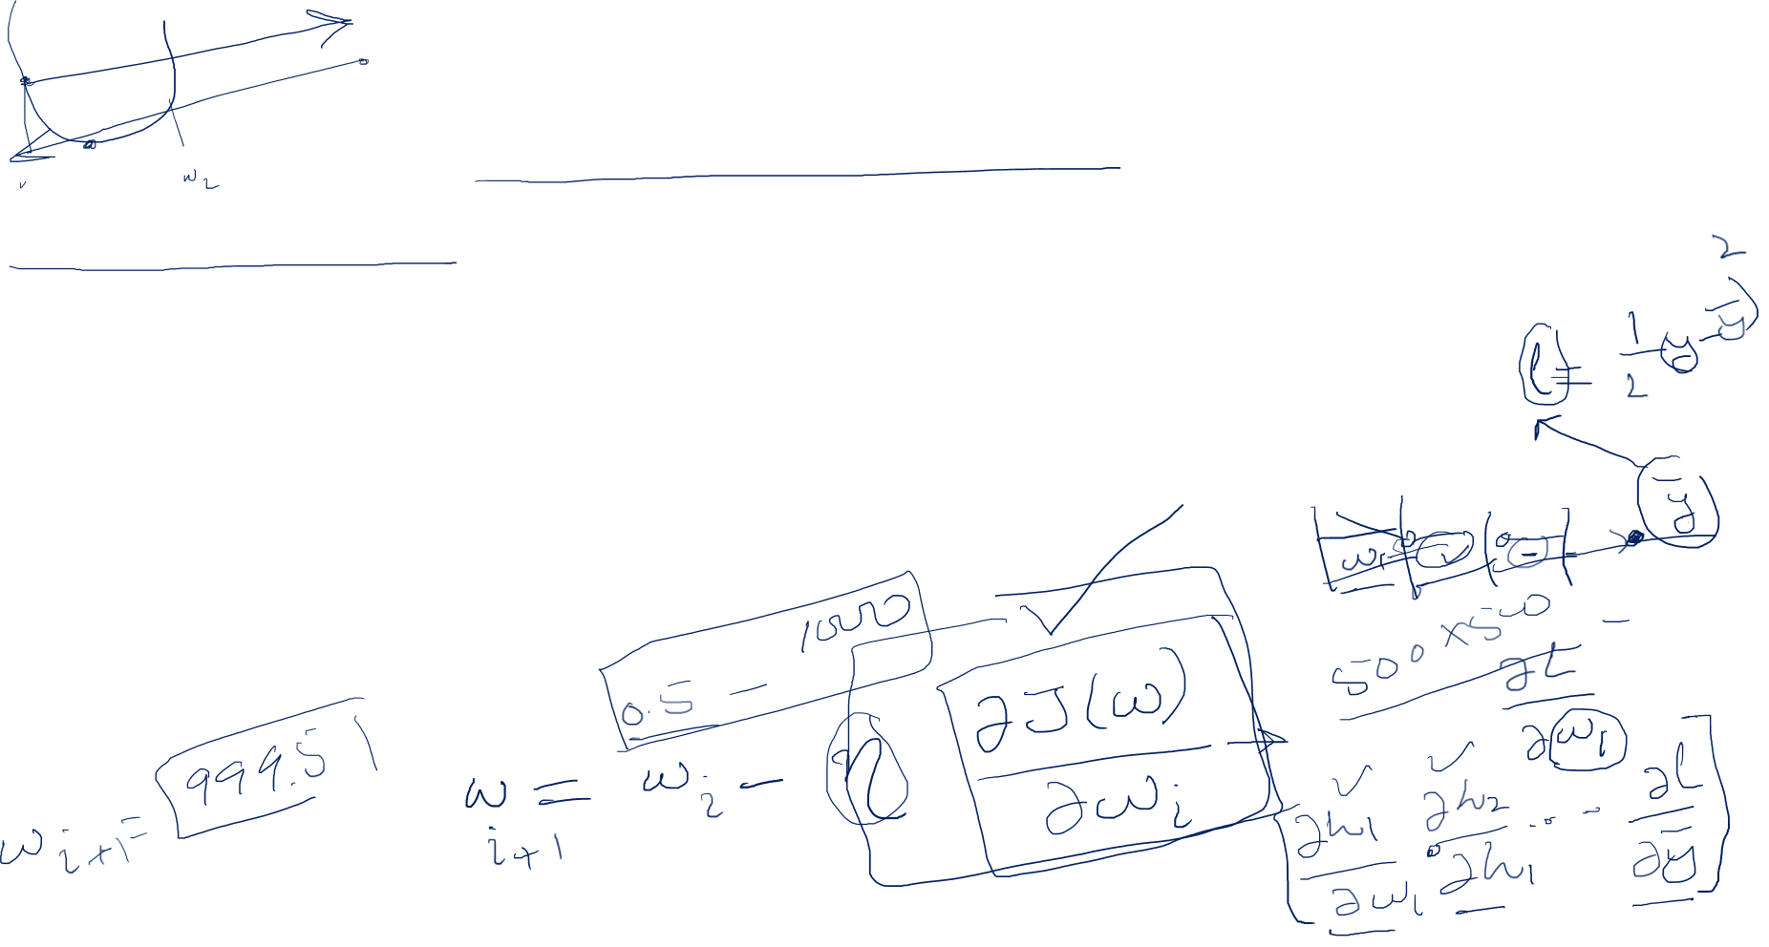
Exploding Gradients
Exploding gradients are a problem where large error gradients accumulate
Result in very large weight updates during training.
Makes model unstable and unable to learn from your training data.
Cause poor predication results

Slide 55
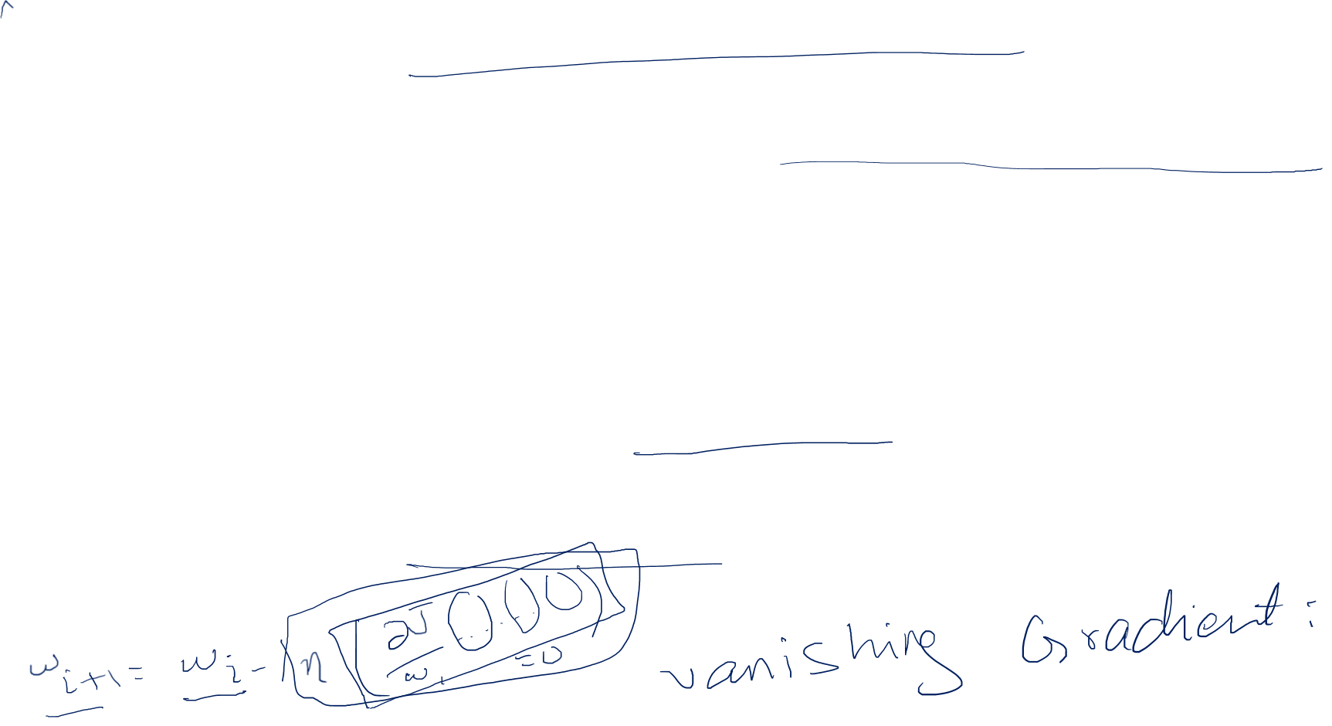
Regularization Technique
Regularization is a technique used to prevent overfitting and improve the generalization of a predictive model.
Overfitting occurs when a model learns to fit the training data too closely
Poor performance on unseen data.
Regularization methods add a penalty term to the model's loss function
Discouraging model from memorizing patterns
Balance between fitting the training data well and maintaining simplicity in the model.

Slide 56
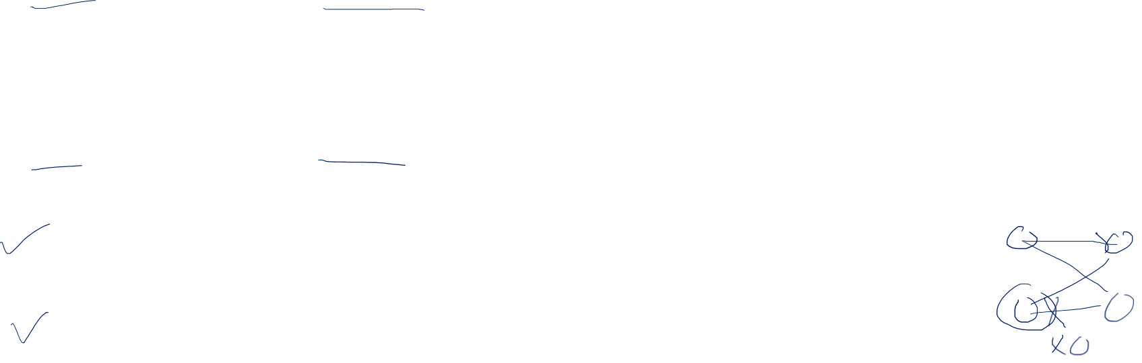
Regularization Technique
Common regularization techniques in machine learning include:
L1 Regularization (Lasso):
L1 regularization adds a penalty term proportional to the absolute values of the model's coefficients.
It encourages sparsity by driving some coefficients to exactly zero, effectively selecting a subset of features.
L2 Regularization (Ridge):
L2 regularization adds a penalty term proportional to the square of the model's coefficients.
It discourages large coefficients and smooths out the parameter values.
Dropout (Neural Networks):
It randomly drops (sets to zero) a fraction of neurons in each layer.
This prevents the network from relying too heavily on any single neuron.
Early Stopping:
Training is halted when the validation performance starts to degrade, preventing the model from overfitting.

Slide 57
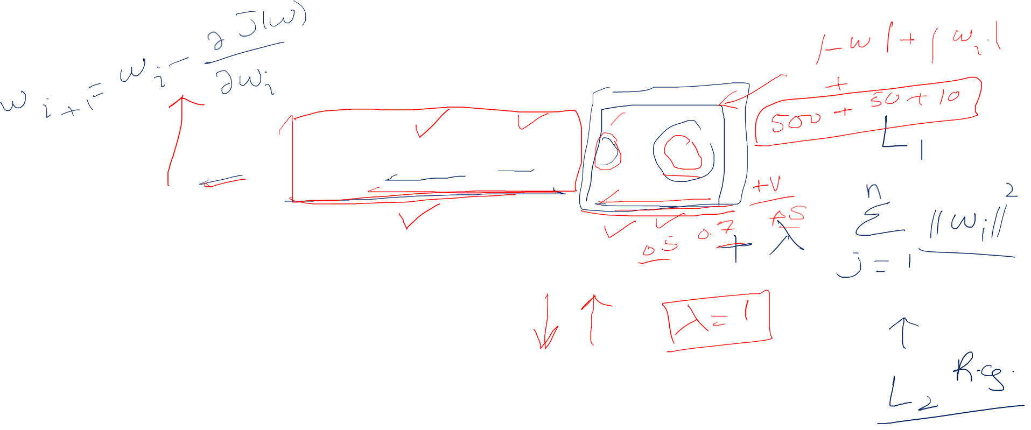
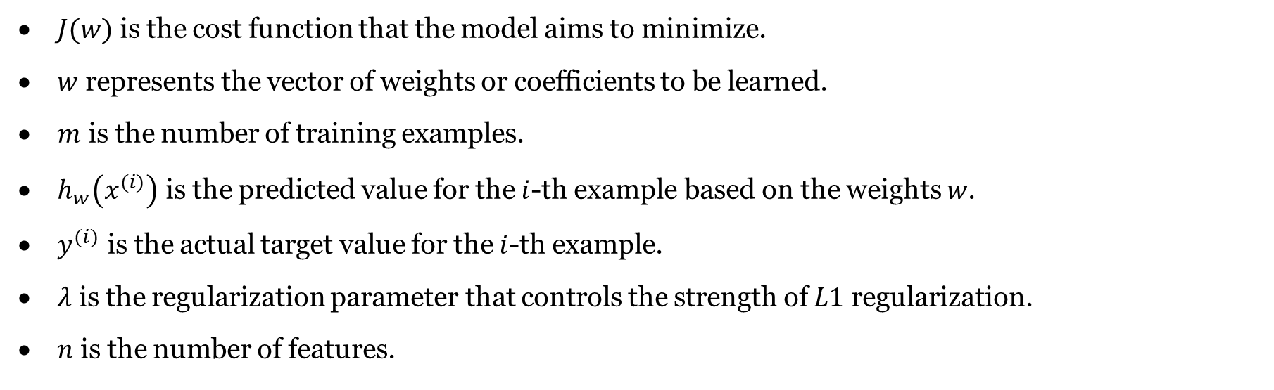
Regularization Technique
$J(w)$ is the cost function that the model aims to minimize.
$w$ represents the vector of weights or coefficients to be learned.
$m$ is the number of training examples.
$h_{w}\left(x^{(i)}\right)$ is the predicted value for the $i$-th example based on the weights $w$.
$y^{(i)}$ is the actual target value for the $i$-th example.
$λ$ is the regularization parameter that controls the strength of $L1$ regularization.
$n$ is the number of features.

Slide 58


Regularization Technique
L1 Regularization
$$w_{j}:=w_{j}−α\left(\frac{1}{m}\sum_{i=1}^{m}{ }\left(h_{w}\left(x^{(i)}\right)−y^{(i)}\right)x_{j}^{(i)}+\frac{λ}{m}sign⁡\left(w_{j}\right)\right)$$

Slide 59

Weight decay
Weight decay is a regularization technique
Simplifying a network and avoiding overfitting is to impose a heuristic that the weights should be small.
To prevent overfitting.
To keep the weights small and avoid exploding gradient.
This will help keep the weights as small as possible, preventing the weights to grow out of control, and thus avoid exploding gradient.

Slide 60


Weight decay
Small weights favor models
Popular due to its simplicity.
After each weight update every w eight is simply “decayed” or shrunk according to:
$$w^{\text{new} }=w^{\text{old} }(1−ε)$$
where 0 < $ε$ < 1
$$J_{ef}=J(w)+\frac{2ε}{η}w^{t}w$$
L2 regularization or weight regularization
Achieves a balance between error and overall weight.

Slide 61
Error surfaces
Generally, a convex error surface is desirable
Local minima: if many local minima are present in the error surface, then it is unlikely that the network will find the global minimum.
Another issue is the presence of plateaus — regions where the error varies only slightly as a function of weights.
Training will be slow.

Slide 62
References
Chapter 5, Deep learning book by MIT
Chapter 4, Neural Networks and Learning Machines, Haykin
Chapter 5, Pattern Recognition and Machine Learning, Bishop
Fei-Fei Li & Andrej Karpathy & Justin Johnson lecture notes
https://www.javatpoint.com/pytorch-backpropagation-process-in-deep-neural-network
https://hmkcode.com/ai/backpropagation-step-by-step/

Slide 63
Thank You ☺

